Slide 1


HTML
Building Web Pages
copyright 2009 trainologic LTD

Slide 2

HTML
Introduction to HTML
HTML Elements and Attributes
HTML Forms
Introduction to CSS
2
copyright 2009 trainologic LTD

Slide 3
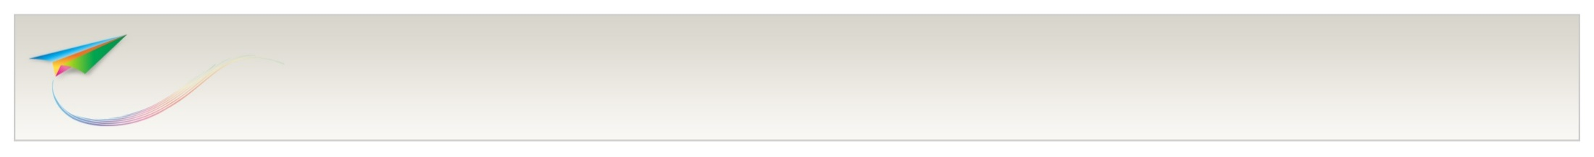
HTML
What is HTML
HTML is a language for describing web pages.
HTML stands for Hyper Text Markup Language.
HTML uses markup tags to describe web pages.
Note that HTML is not a programming language.
HTML tags are keywords surrounded by angle brackets, e.g.:
<html>
<head>
<title>My WebSite</title>
</head>
<body>
<h1> My First HTML </h1>
</body>
</html>
3
copyright 2009 trainologic LTD

Slide 4
HTML
HTML Syntax
HTML tags usually come in pairs like <body> and </body>.
these are called opening tag and closing tag respectively.
HTML documents describe web pages.
HTML documents consist of nested HTML elements:
<html>
<body>
<h1> My First HTML </h1>
</body>
</html>
4
copyright 2009 trainologic LTD

Slide 5
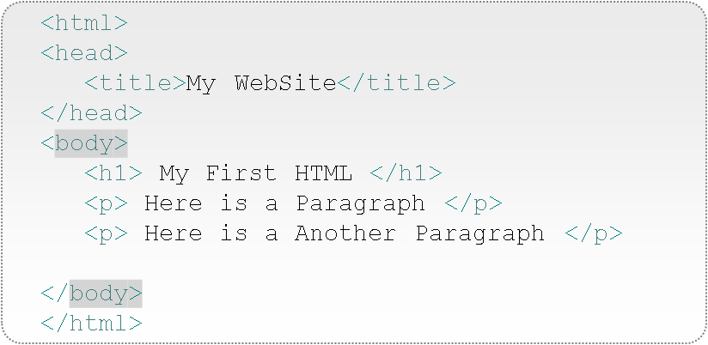
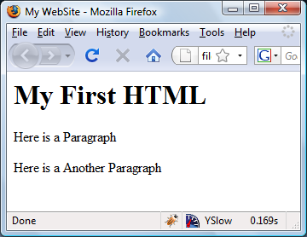
HTML
Basic Example
<html> describes the web page.
<body> is the visible page content.
<h1> is displayed as a heading.
<p> is displayed as a paragraph.
<head> gives information about the page.
<title> is the browser’s window title.
5
copyright 2009 trainologic LTD

Slide 6
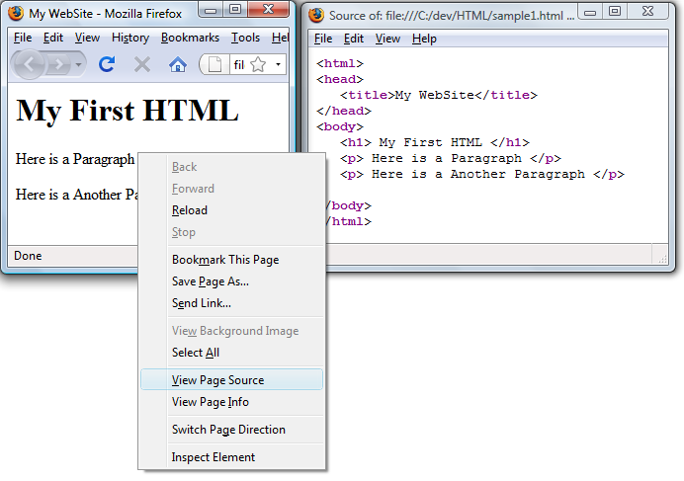
HTML
HTML is the Browser’s “Mother-Tongue”
6
copyright 2009 trainologic LTD

Slide 7
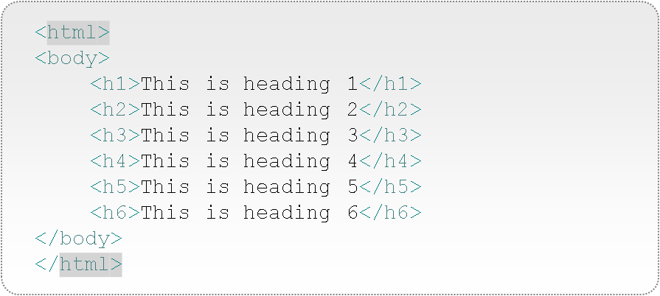
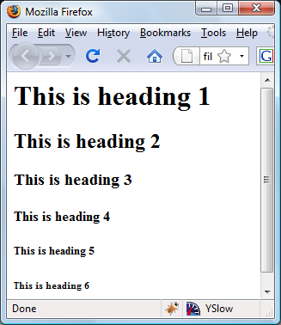
HTML
Headings
These are the headers provided in HTML.
Browsers automatically add an empty line before and after headings.
We will see later that we can change the way they look.
7
copyright 2009 trainologic LTD

Slide 8
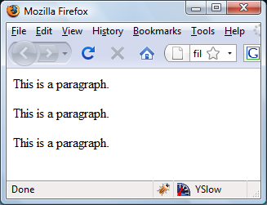
HTML
Paragraphs
<html>
<body>
<p>This is a paragraph.</p>
<p>This is a paragraph.</p>
<p>This is a paragraph.</p>
</body>
</html>
Paragraphs imply a line break and a space from other elements.
8
copyright 2009 trainologic LTD

Slide 9
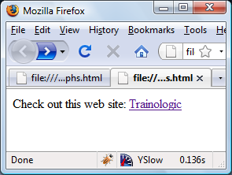
HTML
Links
<html>
<body>
Check out this web site:
<a href="http://www.trainologic.com">Trainologic</a>
</body>
</html>
Links allow us to navigate in the web.
Note that the link address is provided as an attribute, we will talk about attributes shortly.
9
copyright 2009 trainologic LTD

Slide 10
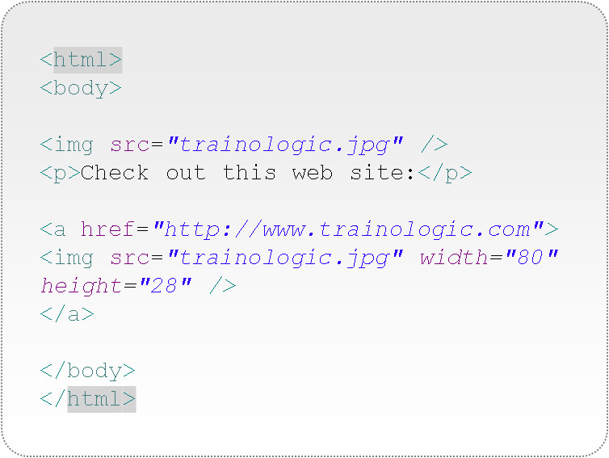
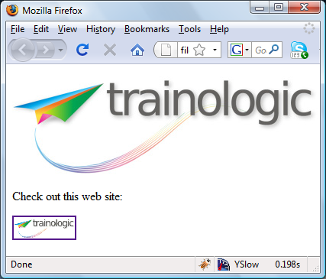
HTML
Images
Note that <img> is an empty element – no closing tag is needed.
More attributes are shown here, we will talk about attributes soon.
10
copyright 2009 trainologic LTD

Slide 11
HTML
Introduction to HTML
HTML Elements and Attributes
HTML Forms
Introduction to CSS
11
copyright 2009 trainologic LTD

Slide 12
HTML
What is XHTML
XHTML is HTML that is also a valid XML Documents.
Adhering to XML rules reduces the probability of making errors and helps your page run correctly on different browsers.
Examine the rules on the next slide.
12
copyright 2009 trainologic LTD

Slide 13
HTML
XHTML Syntax Rules
Close every element with a matching closing tag:
<body>
<p>This is a paragraph.</p>
</body>
Close empty elements by adding a slash to the start tag:
<img src="trainologic.jpg" width="80" height="28" />
Even though some browsers will forgive you for syntax errors, it is highly advised that you use correct syntax.
HTML is not case-sensitive, however, it is recommended to write the tags in lower-case (W3C [World Wide Web Consortium] recommendation).
13
copyright 2009 trainologic LTD

Slide 14
HTML
XHTML Syntax Rules
Most HTML elements can have attributes.
Attributes are additional information about the element.
Attributes come in name-value pairs.
<img src="trainologic.jpg" width="80" height="28" />
Single style quotes are also allowed, useful when the attribute’s value contains double quotes:
Even though it is forgiven by browsers, it is good practice to surround the attribute’s value with quotation marks.
HTML is not case-sensitive, however, write the attribute names in lower-case.
14
copyright 2009 trainologic LTD

Slide 15
HTML
More Useful Elements
<br /> - (break-row) used to break lines.
Note that simple line breaking are translated to spaces.
<hr /> - (horizontal rule) used to draw a line.
You can configure the width of the rule:
<hr width="150" />
You can improve readability using comments (comments are ignored by the browser):
<!-- This is the lists of states,
it is updated when you select a country -->
15
copyright 2009 trainologic LTD

Slide 16
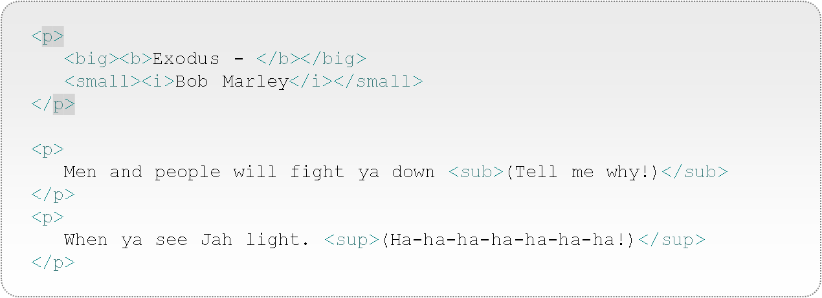
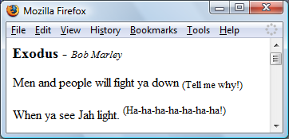
HTML
Text Formatting
16
copyright 2009 trainologic LTD

Slide 17
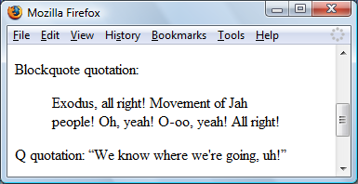
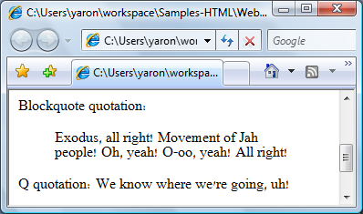
HTML
Text Quotes
Blockquote quotation:
<blockquote>
Exodus, all right! Movement of Jah people!
Oh, yeah! O-oo, yeah! All right!
</blockquote>
Q quotation:
<q>We know where we're going, uh!</q>
Note the different way browsers (IE7, FF3) treat those tags.
17
copyright 2009 trainologic LTD

Slide 18
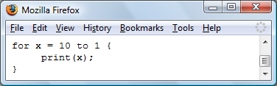
HTML
Preformatted Text
<pre>
for x = 10 to 1 {
print(x);
}
</pre>
Normally, new lines and multiple white spaces are ignored.
Preformatted text is displayed with respect to white spaces and new lines.
18
copyright 2009 trainologic LTD

Slide 19
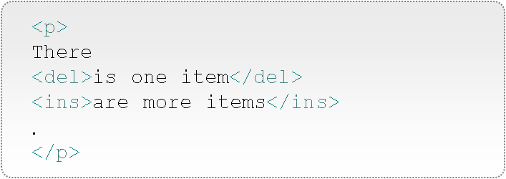
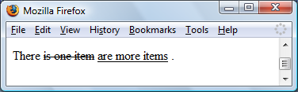
HTML
Deleted and Inserted Text
Not supported by old browsers.
In case it <del> and <ins> are used in such borowser, regular text is displayed.
19
copyright 2009 trainologic LTD

Slide 20
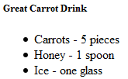
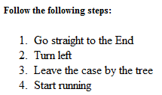
HTML
Lists
Unordered List:
<h5>Great Carrot Drink</h5>
<ul>
<li>Carrots - 5 pieces</li>
<li>Honey - 1 spoon</li>
<li>Ice - one glass</li>
</ul>
Ordered List:
<h5>Follow the following steps:</h5>
<ol>
<li>Go straight to the End</li>
<li>Turn left</li>
<li>Leave the case by the tree</li>
<li>Start running</li>
</ol>
20
copyright 2009 trainologic LTD

Slide 21
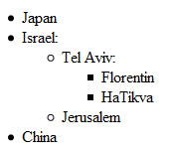
HTML
Nested Lists
It is possible to create nested lists:
<ul>
<li>Japan</li>
<li>Israel:
<ul>
<li>Tel Aviv:
<ul>
<li>Florentin</li>
<li>HaTikva</li>
</ul>
</li>
<li>Jerusalem</li>
</ul>
</li>
<li>China</li>
</ul>
21
copyright 2009 trainologic LTD

Slide 22
HTML
More about Anchors
To open a link in a new window, use:
<a href="http://www.gmail.com/" target="_blank">
Open Gmail (opens a popup window)
</a>
Note that a Popup Blocker may block this window.
The URL can point to any resource available on the web, e.g., picture, movie, etc:
<a href="http://www.google.com/favicon.ico" target="_blank"> Open Gmail Icon
</a>
22
copyright 2009 trainologic LTD

Slide 23
HTML
Named Anchors
Named Anchors are used for linking to a different area in the same page (note the differences):
<a name="pageTop"><h1>Samples</h1></a>
...
...
<a href="#pageTop">Goto Top</a>
Note that the pageTop anchor is not displayed differently.
Linking to a specific section in another page:
<a href="http://www.MyDomain.com/MyPage.html#someSection">
Goto Page at Specific Section</a>
23
copyright 2009 trainologic LTD

Slide 24

HTML
More About Images
The <img> tag is an empty element.
Use the <alt> attribute to improve readability of your page in text-only browsers, or when a browser fails to load an image:
You can modify the size of an image using the width and the height attribute.
Note that the image is downloaded from the server in its real size.
24
copyright 2009 trainologic LTD

Slide 25

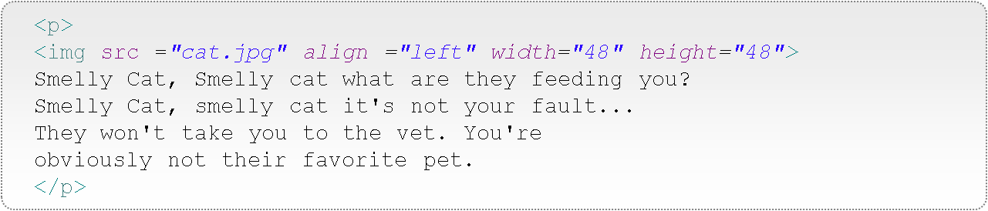

HTML
Aligning Images
Aligning images vertically:
<p> This Cat: <img src="charli.jpg" align="bottom" width="48" height="48"> is Aligned with Text</p>
Aligning images horizontally:
25
copyright 2009 trainologic LTD

Slide 26

HTML
Background Images
For some elements, you can add a background image:
<body background="bg.jpg">
26
copyright 2009 trainologic LTD

Slide 27
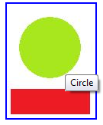
HTML
Image Maps
Use Image-Maps to make different parts of the image clickable hyperlinks.
<img src="shapes.jpg" usemap="#shapesMap">
<map id="shapesMap" name="shapesMap">
<area shape="rect"
coords="4,112,107,144"
title="Rectangle"
href=“showRect.html">
<area shape="circle"
coords="15,58,80"
title="Circle"
href=“ShowCircle.html">
</map>
27
copyright 2009 trainologic LTD

Slide 28

HTML
Image Maps
You can make an image act as Map:
<a href="processSelection.html">
<img src="shapes.jpg" ismap >
</a>
When you move the mouse over the image, look at the status bar to see that the current coordinates are attached to the URL as parameters.
We will understand parameters later on.
28
copyright 2009 trainologic LTD

Slide 29

HTML
Tables
Tables are very useful elements. Here is a simple example:
<table border="1">
<tr>
<td>row: 1, column: 1</td>
<td>row: 1, column: 2</td>
</tr>
<tr>
<td>row: 2, column: 1</td>
<td>row: 2, column: 2</td>
</tr>
</table>
<tr> represents a table-row
<td> represents a cell: table-data
30
copyright 2009 trainologic LTD

Slide 30


HTML
Empty Cells
When a cell is empty, on some of the browsers (e.g., FF), the table will look like this:
Note that the inner line is not drawn. This can be fixed by placing a white space in the td:
<table border="1">
<tr>
<td>row: 1, column: 1</td>
<td>row: 1, column: 2</td>
</tr>
<tr>
<td>row: 2, column: 1</td>
<td></td>
</tr>
</table>
<td>&nbsp;</td>
31
copyright 2009 trainologic LTD

Slide 31

HTML
Table Headers
Tables may have Headers:
<table border="1">
<tr>
<th>header1</th>
<th>header2</th>
</tr>
<tr>
<td>row: 1, column: 1</td>
<td>row: 1, column: 2</td>
</tr>
<tr>
<td>row: 2, column: 1</td>
<td>row: 2, column: 2</td>
</tr>
</table>
<th> is used for headers.
32
copyright 2009 trainologic LTD

Slide 32
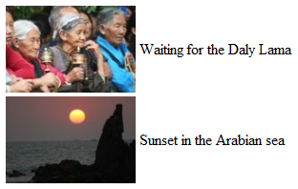
HTML
No-Border Tables
Sometimes, we don’t want the table to show borders. Leave the default or explicitly set the border to 0:
<table border="0" >
<tr>
<td><img src="pic1.jpg"></td>
<td>Waiting for the Daly Lama</td>
</tr>
<tr>
<td><img src="pic2.jpg"></td>
<td>Sunset in the Arabian sea</td>
</tr>
</table>
33
copyright 2009 trainologic LTD

Slide 33

HTML
Tables
Cells may span more that one row / column, here is how:
<table border="1">
<tr>
<th>Name</th>
<th colspan="2">Phones</th>
</tr>
<tr>
<td>Muki D.</td>
<td>763-8796-980</td>
<td>763-3746-731</td>
</tr>
</table>
34
copyright 2009 trainologic LTD

Slide 34

HTML
Tables
Cells may span more that one row / column, here is how:
<table border="1">
<tr>
<th>Name:</th>
<td>Puki G.</td>
</tr>
<tr>
<th rowspan="2">Phones:</th>
<td>763-8796-980</td>
</tr>
<tr>
<td>763-3746-731</td>
</tr>
</table>
35
copyright 2009 trainologic LTD

Slide 35
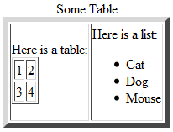
HTML
Nested Tables
Tables may be nested:
<table border="6">
<caption>Some Table</caption>
<tr>
<td>
Here is a table:
<table border="1">
<tr>
<td>1</td>
<td>2</td>
</tr>
<tr>
<td>3</td>
<td>4</td>
</tr>
</table>
</td>
<td>Here is a list:
<ul>
<li>Cat</li>
<li>Dog</li>
<li>Mouse</li>
</ul>
</td>
</tr>
</table>
36
copyright 2009 trainologic LTD

Slide 36


HTML
Tables
Use cellpadding to add padding to the cell.
<table border="1">
<tr>
<td>A</td>
<td>B</td>
</tr>
<tr>
<td>C</td>
<td>D</td>
</tr>
</table>
<table border="1" cellpadding="10">
<tr>
<td>A</td>
<td>B</td>
</tr>
<tr>
<td>C</td>
<td>D</td>
</tr>
</table>
37
copyright 2009 trainologic LTD

Slide 37

HTML
Tables
Use cellspacing to add space between cells.
<table border="1">
<tr>
<td>A</td>
<td>B</td>
</tr>
<tr>
<td>C</td>
<td>D</td>
</tr>
</table>
<table border="1" cellspacing="10">
<tr>
<td>A</td>
<td>B</td>
</tr>
<tr>
<td>C</td>
<td>D</td>
</tr>
</table>
38
copyright 2009 trainologic LTD

Slide 38



HTML
Tables – Borders
Let’s examine different borders styles using the frame attribute:
<table frame="border“>
<table frame=“above“>
<table frame=“hsides“>
...And many more.
Nice, eh?
Unfortunately, these attributes are shown differently on different browsers, so this is not very useful.
39
copyright 2009 trainologic LTD

Slide 39
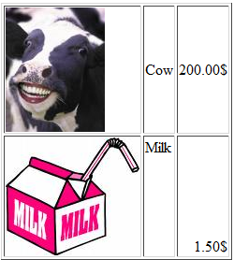
HTML
Aligning Tables’ Cells
Aligning may be done for each cell
<table border="1">
<tr>
<td><img src="cow.jpg" /></td>
<td>Cow</td>
<td align="right">200.00$</td>
</tr>
<tr>
<td><img src="milk.jpg" /></td>
<td valign="top">Milk</td>
<td valign="bottom" align="right">1.50$</td>
</tr>
</table>
40
copyright 2009 trainologic LTD

Slide 40


HTML
More Table Attributes
You may want to change the direction of the entire table, this is done using:
<table border="1" dir="rtl“>
To set a background for your table, use:
<table border="1" cellspacing="5" cellpadding="5" bgcolor="lightgreen">
To set an image background for your table, use:
<table border="1" cellspacing="5" cellpadding="5" background="bg.jpg">
41
copyright 2009 trainologic LTD

Slide 41
HTML
HTML Entities
Some characters (like <) cannot be placed inside the text (the browser might mistake them for tags).
HTML Entities are used to output these special characters.
For example: &lt; is the entity code for <.
The Entity could be specified using the Entity code or an Entity number: &#60;
Entity names are recommended as they are more readable.
However, some Entity names are not supported by all browsers.
42
copyright 2009 trainologic LTD

Slide 42
HTML
HTML Entities
Here are some commonly used Entities:
Entity Output | Description | Code | Number
 | non-breaking space | &nbsp; | &#160;
< | less than | &lt; | &#60;
> | greater than | &gt; | &#62;
& | ampersand | &amp; | &#38;
¢ | cent | &cent; | &#162;
£ | pound | &pound; | &#163;
¥ | yen | &yen; | &#165;
€ | euro | &euro; | &#8364;
§ | section | &sect; | &#167;
© | copyright | &copy; | &#169;
® | registered trademark | &reg; | &#174;
43
copyright 2009 trainologic LTD

Slide 43
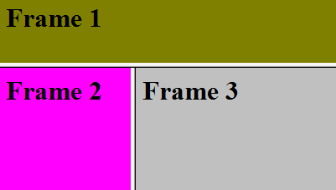
HTML
The Frame Element
Using Frames it is possible to display several HTML documents on the same browser window.
Use the frameset element to declare how the different frames reside on the document.
Note that when using frameset, you don’t use the body element.
Note the usage of * for stating – the remaining space.
<frameset rows="30%,70%">
<frame src="frame1.html" />
<frameset cols="25%,*>
<frame src="frame2.html" />
<frame src="frame3.html" />
</frameset>
</frameset>
44
copyright 2009 trainologic LTD

Slide 44
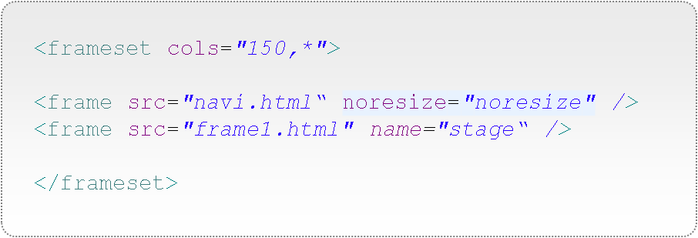
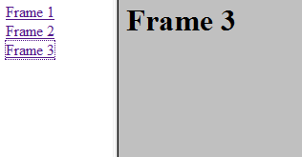
HTML
Navigating to Frames
Navi.html:
<a href ="frame1.html" target ="stage">Frame 1</a><br/>
<a href ="frame2.html" target ="stage">Frame 2</a><br/>
<a href ="frame3.html" target ="stage">Frame 3</a>
45
copyright 2009 trainologic LTD

Slide 45
HTML
Head Elements
The Head element contains information about the HTML document:
Keywords - used by search engines to index and categorize the page.
Content-Type – used by the browser to determine the encoding of the page.
<meta http-equiv="Content-Type" content="text/html; charset=utf-8" />
<meta name="title" content="Frogi Pets Shop" />
<meta name="description" content="The best online pets shop" />
<meta name="keywords" content="Frogi, Pets, Pets Food, cat, dog" />
<meta name="language" content="en" />
46
copyright 2009 trainologic LTD

Slide 46
HTML
Introduction to HTML
HTML Elements and Attributes
HTML Forms
Introduction to CSS
47
copyright 2009 trainologic LTD

Slide 47
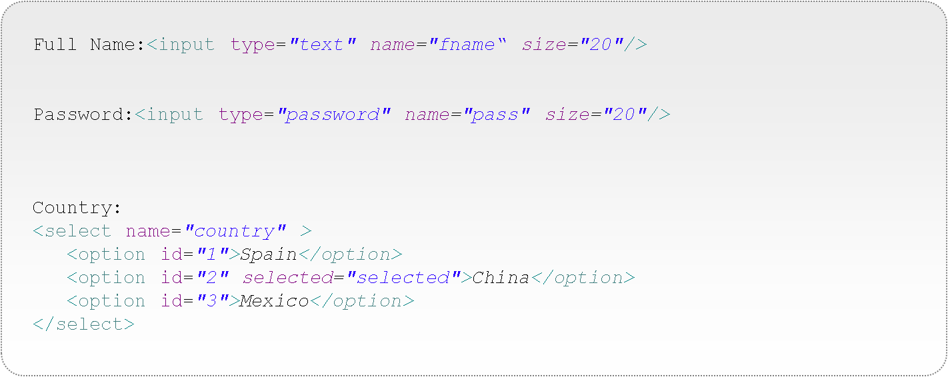

HTML
HTML Input Elements
Input Elements are used to get data from the user:
48
copyright 2009 trainologic LTD

Slide 48


HTML
HTML Input Elements
More input Elements:
<input type="radio" id="gender1" name="gender" value="m" checked="checked" />
<label for="gender1">I am a Male</label>
<input type="radio" id="gender2" name="gender" value="f" />
<label for="gender2">I am a Female</label>
<fieldset>
<legend>Pets Policy:</legend>
<input type="checkbox" name="dog" id="dog" />
<label for="dog">I have a Dog</label><br/>
<input type="checkbox" name="cat" id="cat" checked="checked"/>
<label for="cat">I have a Cat</label>
</fieldset>
49
copyright 2009 trainologic LTD

Slide 49

HTML
HTML Input Elements
Some words about me:<br/>
<textarea name=“desc" rows="3" cols="20">
I am interested in...
</textarea>
<input type="button" value="Push Me" onclick="alert('Hello')" />
Buttons are usually used to activate javascript that creates a dynamic browser-side behavior.
We will see much more power from JavaScript later.
A commonly used button is one that submits the data from the input Elements to the server.
This leads us to HTML forms.
50
copyright 2009 trainologic LTD

Slide 50
HTML
HTML Forms
Form is a logical element, uniting input elements:
<form action=“processSignup.php" method="get">
<input type="text" name="fname" size="20"/>
…
<input type="submit" value="Send to Server" />
</form>
The action element specifies a URL for a server-side file to process the data sent from the browser.
51
copyright 2009 trainologic LTD

Slide 51
HTML
HTML Forms
<form action=“processSignup.php" method="get">
<input type="text" name="fname" size="20"/>
…
<input type="submit" value="Send to Server" />
</form>
The method can be:
get – data is sent as part of the URL and visible to the user, limited by size (1024 characters).
post – data is sent hidden as part of the http request, this is the recommended way.
52
copyright 2009 trainologic LTD

Slide 52
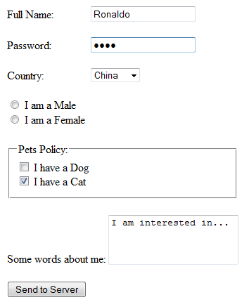

HTML
HTML Forms
Let’s put it all together:
http://www.mydomain.com/processSignup.php?
fname=Ronaldo&
Pass=poli&
country=Mexico&
gender=m&
cat=on&
desc=I+am+interested+in+musica
Server side code will process the parameters, save to DB and redirect to the next page.
53
copyright 2009 trainologic LTD

Slide 53
HTML
Form Hidden Elements
Hidden input elements are not shown to the user.
These are very useful when sending information from the server to the browser and back. Examine the following form:
<form action=“processSignup.php" method="get">
<input type=“hidden" name=“timestampFromServer" value=“112341433"/>
…
<input type="submit" value="Send to Server" />
</form>
When the form gets submitted, the server-side code may check the timestampFromServer parameter to figure out how much time it took the user to fill the form.
54
copyright 2009 trainologic LTD

Slide 54
HTML
Summary
HTML is a markup language used to describe a web page.
HTML Forms are used to send data from the user to the server. Server side code is required to handle the sent data.
66
copyright 2009 trainologic LTD

